Slide 1
Challenges in data acquisition, storage and processing for NIH funded studies
UAB Research Computing Day
September 15, 2011
Stephen Barnes, PhD
Department of Pharmacology & Toxicology and the Targeted Metabolomics and Proteomics Laboratory

Slide 2
Synopsis
Proteomic and genomic “cats”
Federal rules for maintaining data from funded grants
Economics of storing and transferring data
Local Cloud vs Commercial Cloud
Media for Cloud storage

Slide 3


Slide 4
How many cats in 2011?
If we start with 2 cats (male and female) in 2001 and cats breed every 3 months producing a litter of 4 kittens, how many cats will we have today?
At 3 months, we’ll have 4 kittens
At 6 months, we’ll have 8 kittens
At 12 months we’ll have 32 kittens (expanded by 16)
At 5 years, we’ll have 16⁵ kittens = (2^{4*5}) = one million
At 10 years, we’ll have 16¹⁰ kittens = 2⁴⁰
Transfer to OMG units or as they’re better known in IT departments as terabytes

Slide 5
The problem
Analysis is exploding
Imaging
NextGen sequencing
Proteomics
Metabolomics
Have created a world where there are “routine” TB datasets

Slide 6
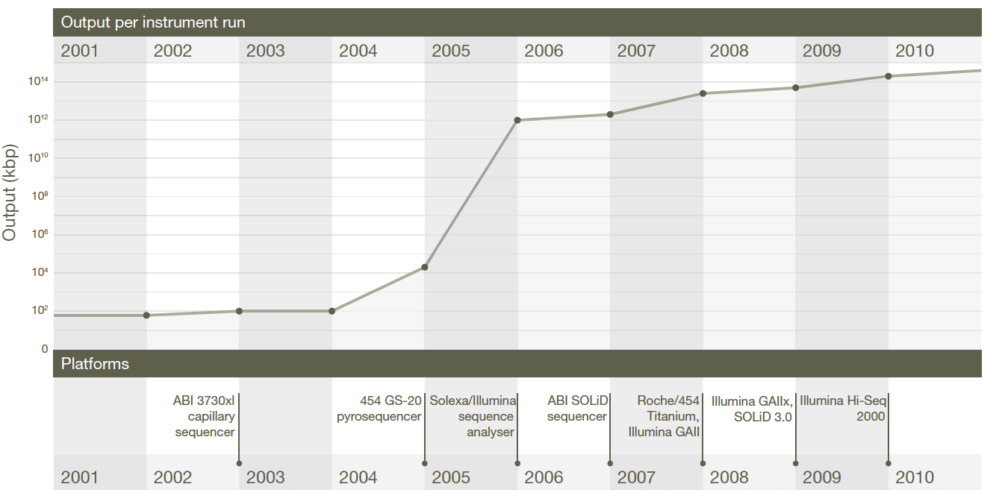
Recent increases in speed of DNA sequencing
Since 2005, DNA sequencing rates have increased 500-fold and are headed higher. The annualized increase is 4.5-fold, i.e., 22.5-fold every two years, an order of magnitude more than Moore’s law in computing.
Mardis ER Nature 470:198, 2011

Slide 7
Expense of Deep Sequencing
Deep DNA sequencing is leading to Terabytes of data per month
If the genomes of the population of the USA were sequenced, this would amount to >1,000 Petabytes of data
1 Terabyte of storage is ~$100
If simple scaling is possible, then it would cost $100 million a year (expected lifetime of the drives) to store the data or approaching $7 billion for the average person’s lifetime (assuming no further population increase)
And that’s without backups, using the data in any way and assuming that Microsoft doesn’t structure your saved files!

Slide 8
NIH requirements for data collected from funded grants
NIH requires you to make available datasets created from federally supported studies
How long should this be after termination of the grant?
Federal rules about “data” state that you must keep them for 3 years
http://grants.nih.gov/grants/policy/nihgps_2010/nihgps_ch8.htm#_Toc271264950
So, who pays for keeping TB datasets?
The investigator doesn’t have financial authority once a grant is over
So, UAB?

Slide 9
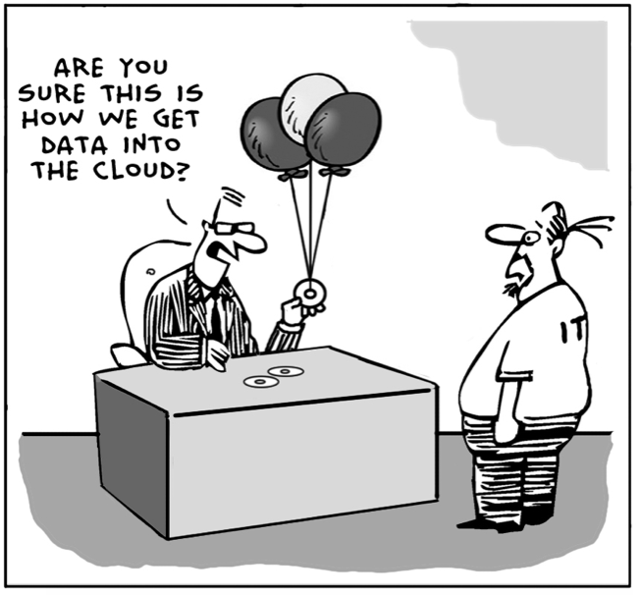
Does the “cloud” present a viable option?
Yes, if we can transfer the data to other computers with greater processing power and cheaper long-term storage, but……..

Slide 10
Whither the cloud?
Depends on the size and capacity of the pipe from the acquisition computer to the computers in the cloud
If we can get data to the cloud, can the software, particularly commercial software, be used for analysis in the cloud?
Opportunity for companies to go to a different business model where there is one, always up-to-date version of their software in the cloud and users pay a small fee for each time they use it

Slide 11
Principal issues posed at Bio-IT 2011
Can cloud infrastructure can support high-throughput data analysis pipelines designed for next-generation sequencing data?
“The cloud is a valuable option for small research centers that lack the resources to purchase and maintain in-house infrastructure”
“For large centers like the Broad Institute (or UAB), which require almost constant compute power to manage and move files ranging from 1 gigabyte to 1 terabyte in size, the cloud, at least for the present, does not seem to be a cost-effective option.”

Slide 12
Economics of the cloud
Estimated cost of traditional storage is $3.75 per Gigabyte-month
Amazon cost – $0.15 Gigabyte-month
CPU cost estimated at $2.63-$3.33 per CPU-hour
Microsoft Azure cost - $0.12 CPU-hour
The cloud, if you can get there, offers substantial savings
From Virtualization and Cloud Computing – Digital Realty Trust, February 2011

Slide 13
Tb storage costs in the Cloud
$0.15/GB/month ➔ $150/TB/month
Annual cost ➔ $1,800/TB/year
Commercially, “life-time storage” is $3,000
For our group, ONE machine generates 2 TB each month
Annualized cost $78,000
Conclusion: Cloud HD storage is not viable

Slide 14
Other models to consider
Do we really need to have high speed access to old data?
Is a tape back up system viable?
Google still uses it as their long-term storage system
One tenth of the costs of HD storage
This reduces 1 TB storage to $15/month or $180/year

Slide 15
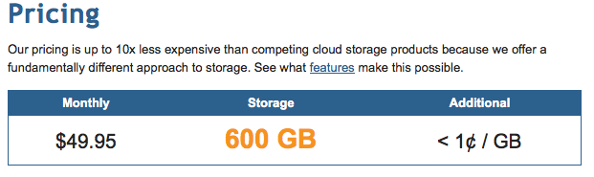
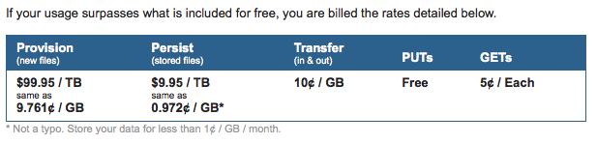
Costs of tape storage
http://www.bitbunker.com/pricing
If an investigator uploads a 200 GB file, this costs $20. It also costs $20 each time it is downloaded. This will be a cost borne by the investigator.

Slide 16
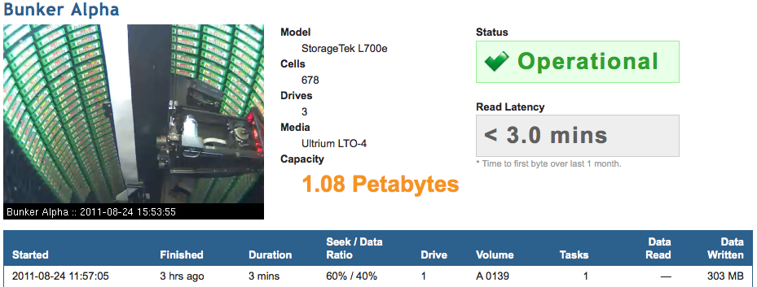
The robotic tape storage system
Download time is consistent with the time to get a coffee or a Coke, or take a quick bathroom break.

Slide 17
Summary and the future
Biomedical research is generating volumes of data that strain the current system for data transport and storage
There are two options
Gaining access to very fast pipes from UAB NextGen and other UAB data generating centers to existing regional fast pipes and on to the commercial cloud
Creating very fast pipes from UAB NextGen and other UAB data generating centers to a UAB cloud
Storage costs of large data sets has become an economic heavyweight
Is a tape system the solution for NIH data?
Software may not be transferrable to the cloud
Security issues need good solutions for all parties

Slide 18
Acknowledgements
David Shealy, PhD
Chiquito Crasto, PhD
Jonas Almeida, PhD
John-Paul Robinson
Scott Sweeney
Landon Wilson
Mikako Kawai
Chandrahas Narne
NCCAM R21 AT004661
NCRR S10 RR027822

